Slide 1
The Business of Trailer Music with Position Music’s Emily Weber

Slide 2
Emily Weber: VP of Creative Licensing - Trailers | Promos | International
Emily Weber is the VP of Creative-Music for Trailers and Promos at Position Music. Emily has over 14 years of experience pitching music for Trailers, and Film/TV both domestically and in Europe.
She has A&R’ed many of the trailer or sound design albums in Position Music’s catalog and has licensed music in dozens of movie trailers including these most recent ones: Snowden, Tarzan, X-Men Apocalypse, Independence Day: Resurgence, The Magnificent Seven, and Fear of The Walking Dead.

Slide 3
About Position Music:
Founded in 1999 by Tyler Bacon, Position Music is a Independent Music Publisher and Record Label with a focus on Sync Licensing. They are all about developing, supporting and partnering with great artists and producers.
Position Music has a large catalog of independent artists and composers, and has had thousands of placements in Advertisements, Films, TV, Video Games, Trailers, and Soundtracks.
In 2005, when the company was having success in licensing commercial artists for movie trailers, they began to explore more opportunity to create the best Trailer Music in the world.
They are proud to have worked closely with composers such as Joseph Trapanese, Adam Peters, James Dooley, Jack Trammell, Danny Cocke and many more.
www.positionmusic.com

Slide 4
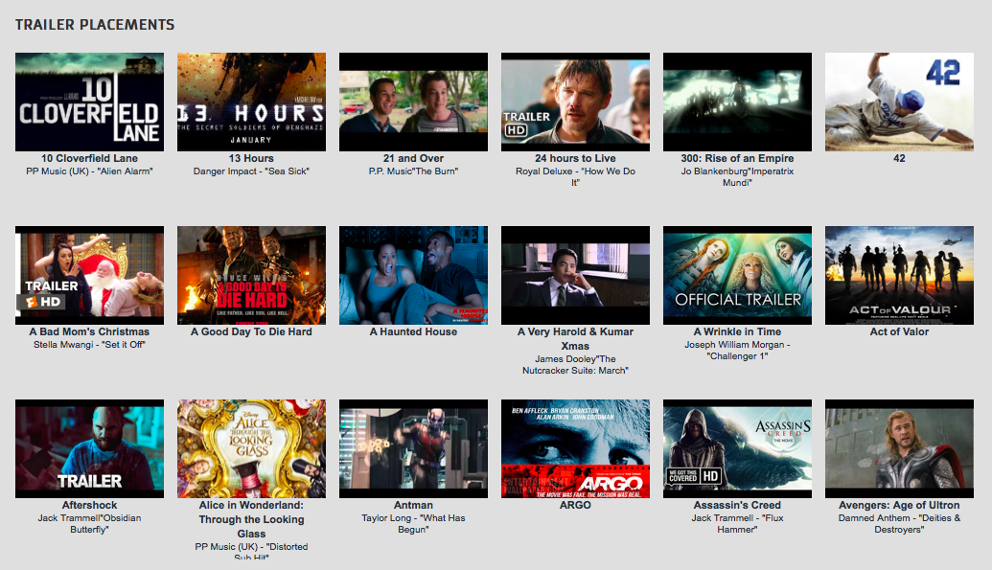
See more at: positionmusic.com/placements

Slide 5
About Synchtank:
Synchtank is a cloud-based software platform for managing and monetizing digital music assets. Our clients include British Telecom, Disney, Fox, peermusic, Red Bull, Sony and Vice.
Get in touch: enquiries@synchtank.net
www.synchtank.com

Slide 6
Why Trailer Music?
The trailer business is booming – more people are watching them on more platforms than ever before.
A great example of the power of a trailer placement is Position’s recent sync of 2WEI - "Survivor" (Destiny's Child Cover) in the Tomb Rader trailer #2.
All of this content requires music, and music is a hugely important element in the crafting of a successful trailer. Therefore, trailer music presents huge opportunities for music rights holders and composers.
Trailers require a huge range of music, from bespoke compositions to existing commercially successful songs, so there’s opportunity for a wide variety of catalogs and musicians.

Slide 7
Types of Trailers
Film/TV: Films, TV Shows, Documentaries, Networks (e.g. HBO) promo trailers, special trailers/promos for big events - e.g. Comicon.
Video Games: Game launch trailers, Gameplay trailers, special trailers/promos for big gaming events - e.g. E3, Gamescom.
Trailer formats: Theatrical, online (YouTube, social media platforms, mobile, etc), DVD trailer, shorter ‘teaser’ trailers.

Slide 8
The Process & Key Personnel - Film/TV
Who are the main people involved? (see ‘Useful Resources’ slide for a list of Trailer Houses)
What, typically, are they looking for - bespoke composition vs existing compositions, well-known songs, one stop, etc.
Workflows/timeframes.
Typical budgets that you come across.
Negotiating deals - what variables are involved? How much can you expect to earn?
How have new on-demand platforms like Netflix, Hulu, and Amazon Prime changed the game?

Slide 9
The Process & Key Personnel – Video Games
Who are the main people involved?
What, typically, are they looking for - bespoke composition vs existing compositions, well-known songs, one stop, etc.
Workflows/timeframes.
Typical budgets that you come across.
Negotiating deals - what variables are involved? How much can you expect to earn?
How have new platforms like Twitch and sectors like eSports changed things up?

Slide 10
Finding Talent / The Artistic Process
Finding and developing/nurturing talent - Position has an amazing roster of artists and composers. What specifics do you look for in these musicians, and how do you collaborate with your A&R department?
Are you looking to work with new artists and composers? Can people get in touch with you?
Best practices for building up a catalog of trailer music, from live orchestra recordings to trailerized cover albums, and so on.
Bespoke compositions - how do you work with your composers/artists/producers on bespoke compositions?
Collaboration - Do you encourage collaboration across your roster?

Slide 11
Finding Opportunities and Building Relationships
Identifying opportunities – is there a way to find out what the trailer companies are currently working on?
Where are you seeing the most opportunities currently?
What are your best practices for proactively finding these opportunities?
Would you advice composers and rightsholders to employ third party agencies to find opportunities on their behalf?
If you are a composer, can you work directly with a trailer producer or should you always go through a third party?

Slide 12
Building Relationships / Promoting Your Catalog
Attending events/conferences.
Hosting showcases.
Inviting key people to gigs.
Sending out regular update emails (only to people who have opted-in).
Having a great social presence – letting the world know about your music and your latest placements.
Having a great website that showcases your catalog and lets potential buyers search for what they need.
Creating and updating regular playlists.
Generally being professional and efficient to ensure repeat business.

Slide 13
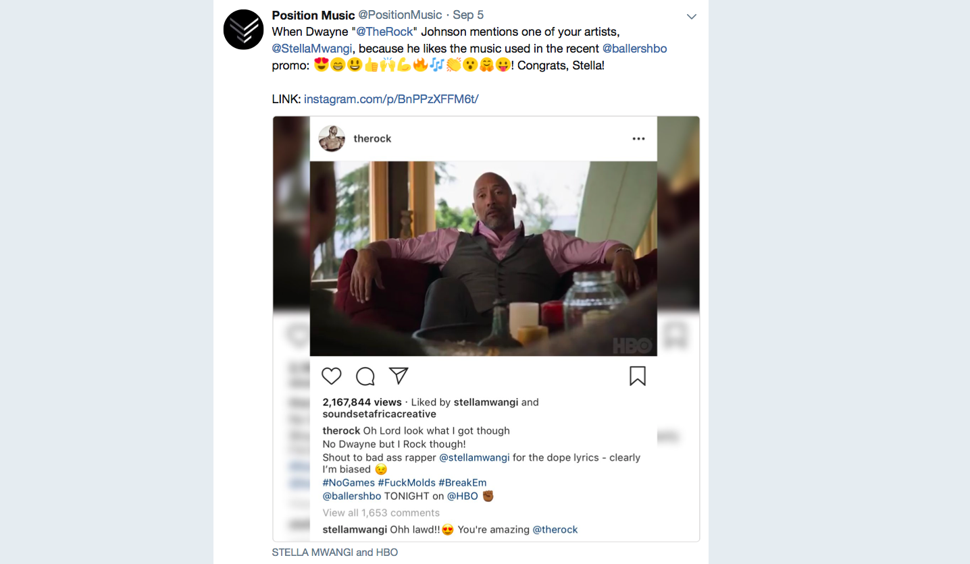

Slide 14
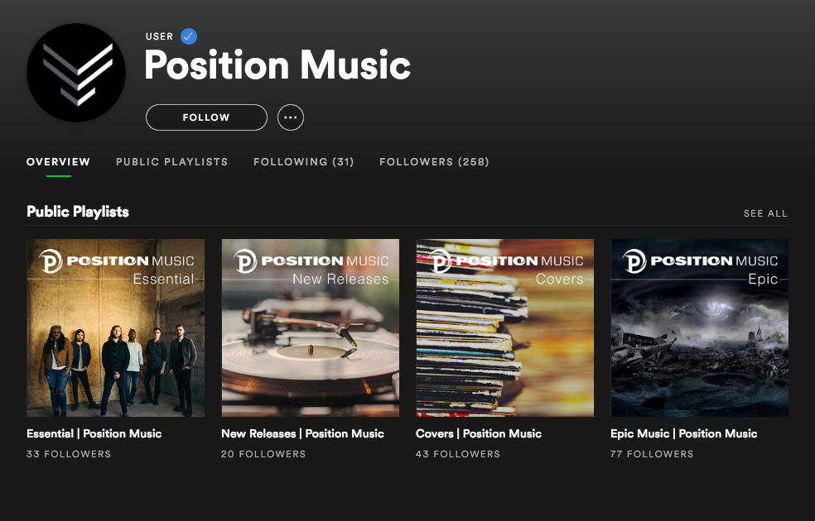

Slide 15
Pitching for Trailer Opportunities
Do your research: Watch trailers, get to know the current trends.
Understand where your value lies: Identify your strengths and weaknesses as a company/composer.
Be personable and relevant: Never send someone a generic, mass email. Show that you’ve done your research and add a personal touch.
Keep it short and sweet: Send a couple of your best/most relevant tracks, not your entire album or back catalog.
Have stems and multiple versions/file types available: Instrumentals, stems, alternative mixes, mp3s/WAVs.
Don’t attach mp3s or other files: Instead provide a link to stream/download your music.
Label everything: Ensure your metadata is perfect for every track.
Be flexible: You may be required to make last minute edits or re-records.
Ensure that your music is of the required quality.

Slide 16
Popular Approaches and Emerging Trends
Frequently employed creative approaches in trailer music:
Cover recordings
‘Trailerizing’ of popular songs
Remixes
Sound design
Score from other films/TV shows in trailers
Overlays
Customizations
Emerging trends:
What emerging trends are you currently noticing?
Do you notice different trends in different territories?
How are technologies like VR making an impact?

Slide 17
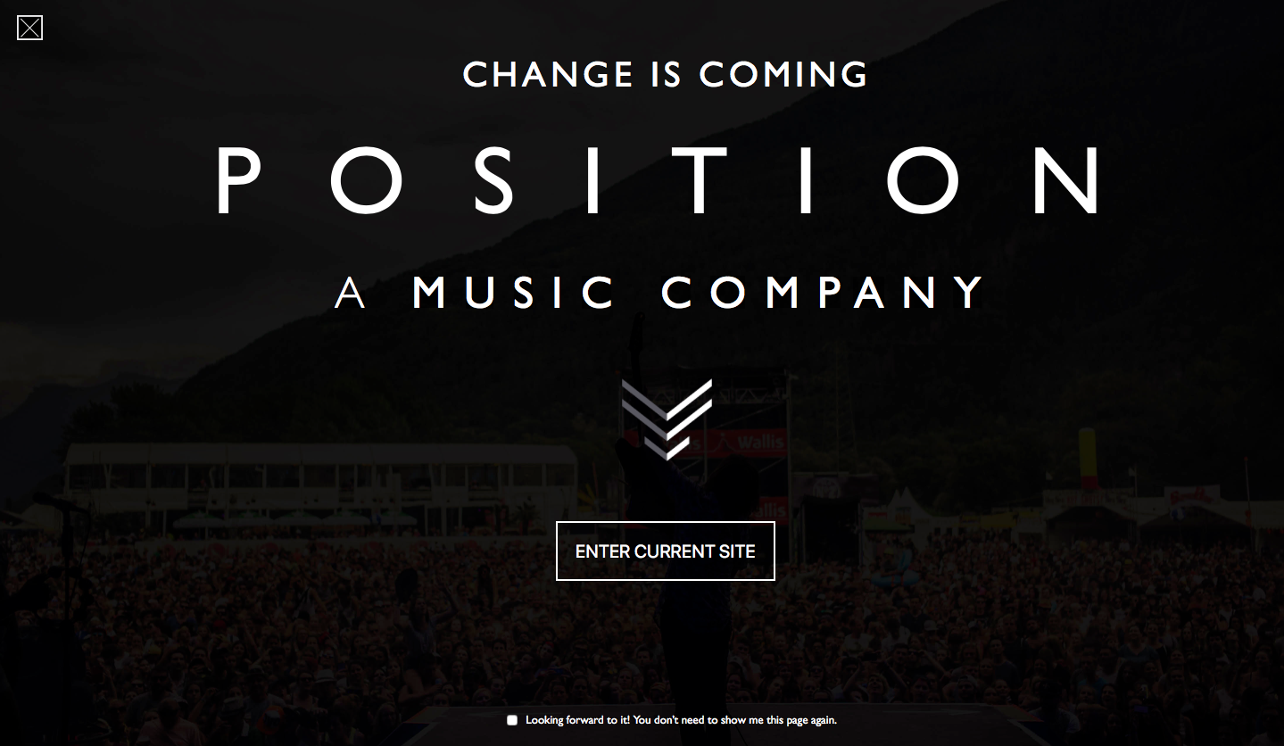

Slide 18
Useful Resources
Golden Trailer Award’s Trailer House Directory
Key Worldwide Music Industry and Sync Events List 2018
Trailer Parks VP of Music Bobby Gumm on the Craft & Business of Trailer Music
Trailaurality.com
A Look at Trends in Trailer Music – Part 1 | Part 2
The Art of Trailer Music
Traileraddict.com
Comingsoon.net

Slide 19
Find us at www.synchtank.com.
Check out our blog Synchblog for industry news and advice.
Follow us on Twitter, LinkedIn, Facebook, Instagram - @Synchtank.
Sign up to our Synchtank Weekly newsletter.
Get in touch: enquiries@synchtank.net.

